Slide 1
Heat Transfer
Conduction with Thermal Energy Generation

Slide 2
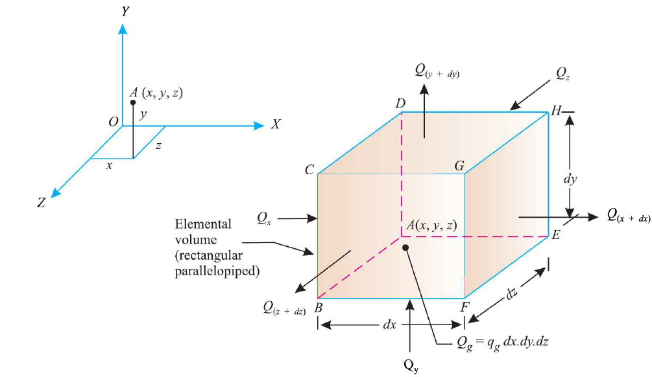
Heat conduction equation in Cartesian cooridnates

Slide 3
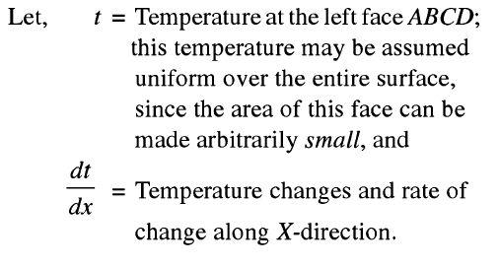



Slide 4
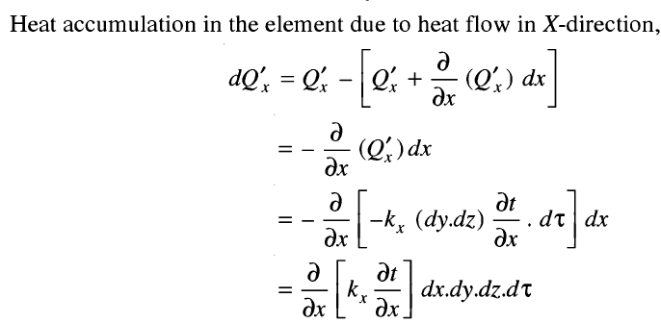
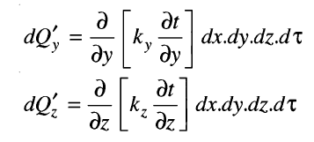

Slide 5
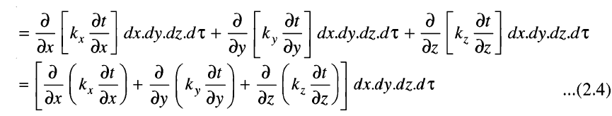
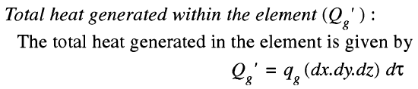

Slide 6


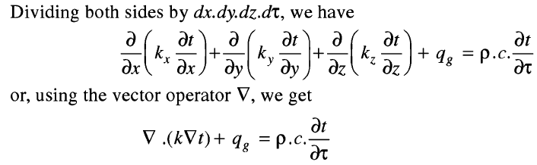

Slide 7



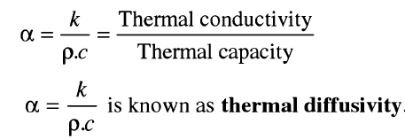
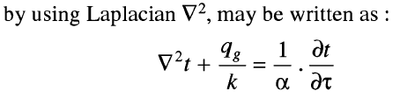

Slide 8
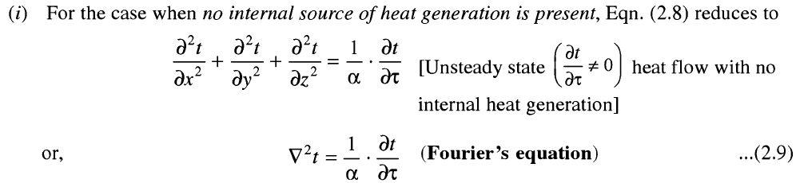
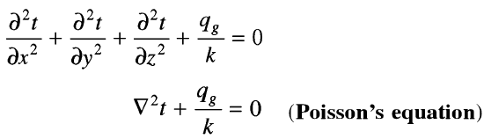

Slide 9
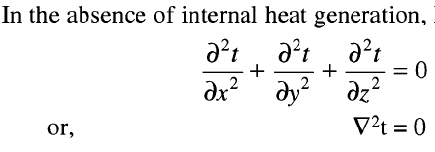


Slide 10
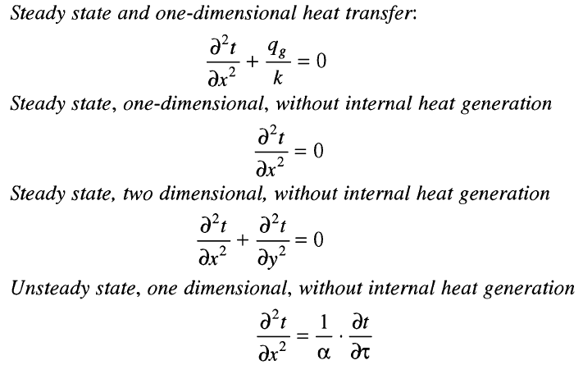

Slide 11
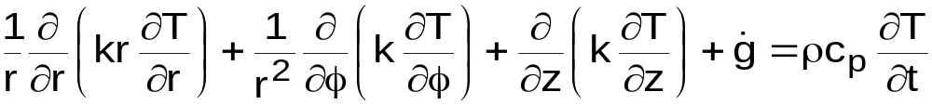
Heat equation in cylindrical coordinates (r, Φ, z)
Where, x= r cos Φ, y= r sin Φ, z = z.
Heat equation in spherical coordinates (r, Φ, θ)
Where, x= r sin θ sinΦ, y= r r sin θ cos Φ, z = z.
r
z
T (r, Φ, z)
y
Φ
x
z
θ
r
T (r, Φ, z)
y
Φ
x

Slide 12
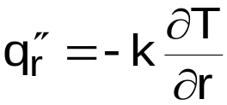
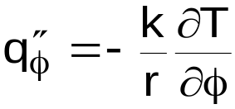
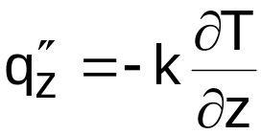

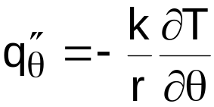
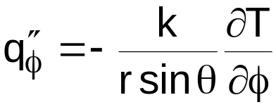
For a cylinder, the heat components in the radial, circumferential, and axial directions are respectively,
For a sphere, the heat flux components in the radial, polar, and azimuth directions are respectively,

Slide 13

Conduction With Thermal Energy Generation
Energy Generation Process
Electrical to thermal energy conversion
  E_{g} = I² R_{e} = W = Power generation (Watts)
I = current, R_{e} = electrical resistance
For a medium of volume V, the volumetric generation rate q (W/m) is
  Exothermic chemical reactions → Energy gen.
  Endothermic chem. Reactions → Energy sink
  Thermal energy sink → Conversion of thermal energy to chemical bonding energy
  Electromagnetic energy (waves) → Thermal energy by radiation absorption ( e.g. gamma ray absorption in a nuclear component or visible radiation absorption in a semi-transparent material, such as glass.

Slide 14

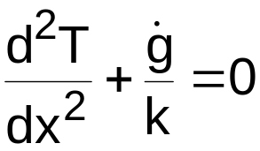
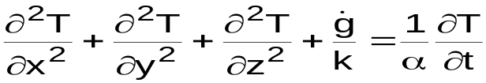
2. The Plane Wall
Consider the plane wall shown below with uniform energy generation (g) per unit volume.
Appropriate Heat Diffusion Equation with constant k, S.S. condition and 1-D:
q=f(x)
q₁”
T _{∞,2}, h₂
q”
T _{∞,1}, h₁
T _{s,1}
T _{s,2}
T _{∞,1} ≠ T _{∞,2}
x=-L
x=0
x=L

Slide 15
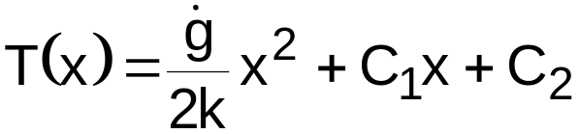
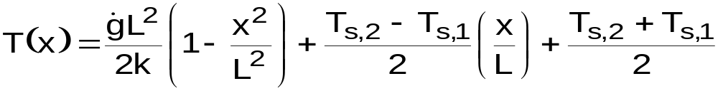
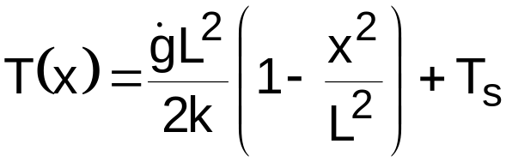
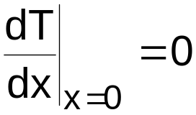
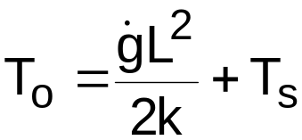
General Solution:
  Applying the B.C.’s to obtain C₁ and C₂ and substituting in the G.S., we have:
Special Case:
  When T _{s,1} = T _{s,2} = T_{s}, the temperature distribution is symmetrical about the midplane, and is given by:
  The maximum temperature at the centreline where
  is given by:
T _{o}
T _{s}
T _{s}
-L
x=0
L

Slide 16
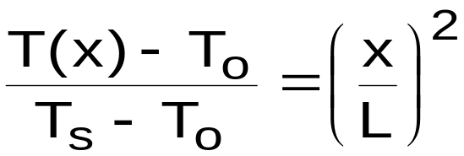
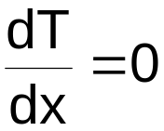
The corresponding temperature distribution is:
In most situations, T_{s} is not known. However, the adjacent fluid temperature (T∞) is usually given, and T_{s} must be expressed in terms of T∞ in order to apply the above temperature equations. This is obtained as follows:
Adiabatic Surface
T _{s}
T _{s}
T _{s}
-L
x=0
L
x=0
L

Slide 17

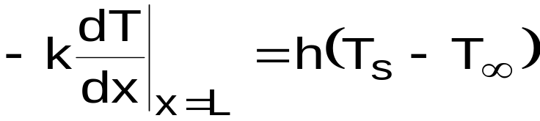
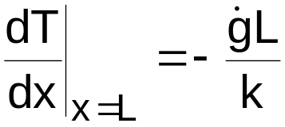
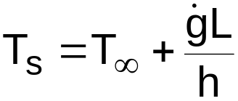
From a surface energy balance we have:
q_{conv}”
q_{cond}”
Fluid
T ∞, h
T_{s}
Since
then
Substituting the above equation for dT/dx in the surface energy balance gives:
For the symmetrical or adiabatic wall

Slide 18

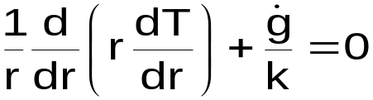
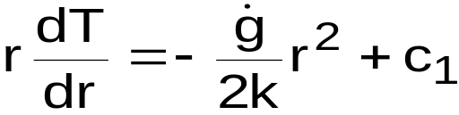
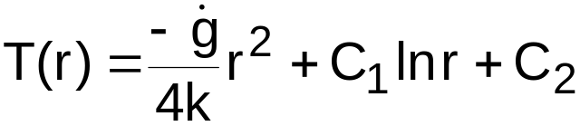
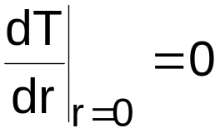

3. Radial Systems
For a cylinder with internal heat generation, ( = constant), at S.S. conditions and constant properties, the 1-D, Heat Equation for cylindrical coordinates is:
By separating variables the above equation can be integrated to
give:
or
General solution
From Symmetry the B.C.’s are
T ∞, h
T_{s}
and
L
r

Slide 19
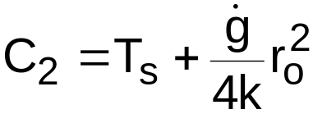
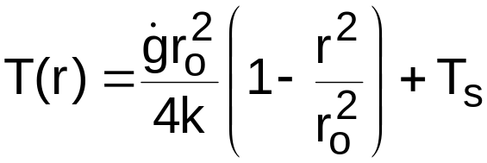
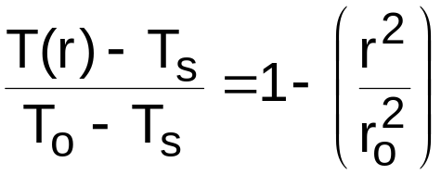
From the B.C. at r = 0, i.e. , we obtain C₁ = 0
Using the second B.C. at r = r_{o} or T(r=r_{o})=T_{s}, we obtain:
The solution for 1-D, S.S., conduction with = constant and T_{s} = constant for a solid cylinder is:
Or in dimensionless form
where T₀ = the centreline temperature

Slide 20

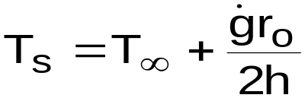
The heat transfer rate q(r) can be evaluated from the temperature distribution equation and Fourier’s Law.
Often we know T∞ rather than T_{s}. In this case, we relate T_{s} to the fluid temperature outside the cylinder (T∞) by applying a surface energy balance:
Temperature Distribution, Heat flux and Heat rate equations are given for different boundary conditions (First, Second, or Third kind) with uniform energy generation.
q_{cond}”
q_{conv}”
Fluid
T ∞, h
T_{s}

Slide 21
1.The rate of heat generation in a slab of thickness 160 mm (k=180W/mK) is 1.2 x 10⁶ w/m³. If the temperature of each of the surface of solid is 120ºC, determine : (i) the temperature at the mid and quarter planes (ii) the heat flow rate and temperature gradients at the mid and quarter planes.
2. A Plane wall of 10 cm thick generates heat at the rate of 4 x 10⁴ W/m³ when an electric current is passed through it. If h= 50W/m²K. Determine surface and maximum temperature in the wall. Assume the ambient air temperature as 20ºC and thermal conductivity of the wall material to be 15W/mk.
3. The temperatures on the two surfaces of a 25mm thick steel plate (k= 48 W/mK) having a uniform volumetric heat generation of 30 x 10⁶ W/m³. are 180º C and 120 º C. Neglecting the end effects, Determine the following (i) The temperature distribution across the plate (ii) The value and position of the maximum temperature and the heat flow from each surface.

Slide 22
4. A current of 300 Amperes passes through a stainless steel wire of 2.5mm dia and k = 20 W/mK. The resistivity of the wire is 70 x 10⁻⁸ ohm-m. The length of the wire is 2 m. If the wire is submerged in a fluid maintained at 50ºC and convective heat transfer co-efficient at the wire surface is 4000 w/m²K. Calculate the steady state temperature at the centre and at the surface of the wire.

Slide 23
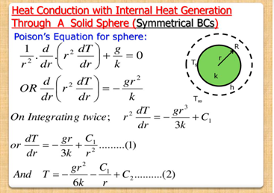

Slide 24
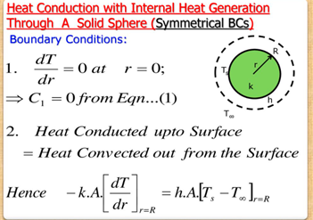

Slide 25
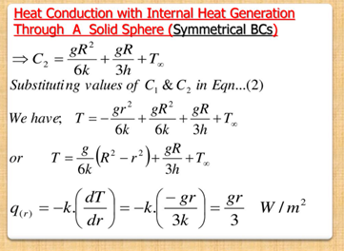

Slide 26
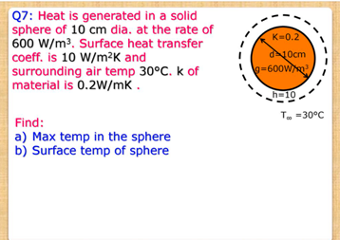

Slide 27
